Slide 1
Introduction
What is image segmentation?
  Technically speaking, image segmentation refers to the decomposition of a scene into different components (thus to facilitate the task at higher levels such as object detection and recognition)
  Scientifically speaking, segmentation is a hypothetical middle-level vision task performed by neurons between low-level and high-level cortical areas
There is no ground truth to a segmentation task (an example is given in the next slide)
EE465: Introduction to Digital Image Processing Copyright Xin Li

Slide 2
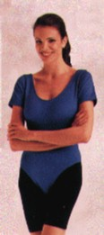


Dilemma
input
result 1
result 2
What do we mean by “DIFFERENT” objects?
Another example: when we look at trees at a close distance, we consider
each of them as a different object; but as we look at trees far away, they
merge into one coherent object (woods)
EE465: Introduction to Digital Image Processing Copyright Xin Li

Slide 3
Overview of Segmentation Techniques
Edge-based
Document images
Color-based
Medical images
Texture-based
Range images
Biometric images
Disparity-based
Texture images
Motion-based
EE465: Introduction to Digital Image Processing Copyright Xin Li

Slide 4


Edge-based Techniques
Segmentation
by boundary
detection
Edge
detection
Classification
and analysis
EE465: Introduction to Digital Image Processing Copyright Xin Li

Slide 5

Region-Filling
EE465: Introduction to Digital Image Processing Copyright Xin Li

Slide 6
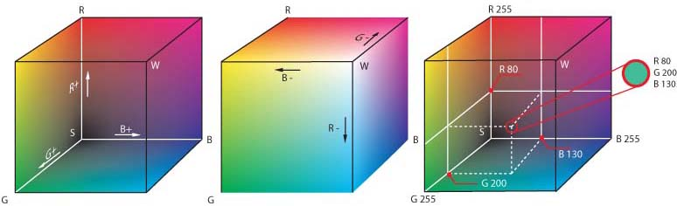
Color-Based Techniques
Color representations
  Device dependent: RGB (displaying) or CMYK (printing)
  Device independent: CIE XYZ or CIELAB (L*a*b*)
There are different specifications of RGB color spaces (e.g., HP/Microsoft vs. Adobe)
EE465: Introduction to Digital Image Processing Copyright Xin Li

Slide 7



Color Space Conversion
Analog
TV
Digital
TV(MPEG)
EE465: Introduction to Digital Image Processing Copyright Xin Li

Slide 8

Clustering via K-Means Algorithm
An algorithm for partitioning (or clustering) N data points
into K disjoint subsets S_{j} containing N_{j} data points so as to
minimize the sum-of-squares criterion
data points
centroid
Initialization: randomly choose
K centroids
the data points are assigned to the K sets
the centroid is updated for each set
EE465: Introduction to Digital Image Processing Copyright Xin Li'2004

Slide 9
Subproblem I: Clustering by distance to known centers

Slide 10
Subproblem II: Finding the centers from known clustering

Slide 11
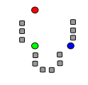
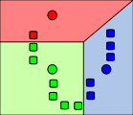
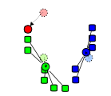
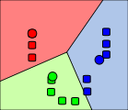
Toy Example of Kmeans Clustering
1.Initialization
2.NN-Clustering
3.Codeword-update
4. Alternate 2 and 3
until convergence
http://home.dei.polimi.it/matteucc/Clustering/tutorial_html/AppletKM.html

Slide 12
K-means Clustering: Step 1
Algorithm: k-means, Distance Metric: Euclidean Distance
5
4
k₁
3
k₂
2
1
k₃
0
0
1
2
3
4
5

Slide 13
K-means Clustering: Step 2
Algorithm: k-means, Distance Metric: Euclidean Distance
5
4
k₁
3
k₂
2
1
k₃
0
0
1
2
3
4
5

Slide 14
K-means Clustering: Step 3
Algorithm: k-means, Distance Metric: Euclidean Distance
5
4
k₁
3
2
k₃
k₂
1
0
0
1
2
3
4
5

Slide 15
K-means Clustering: Step 4
Algorithm: k-means, Distance Metric: Euclidean Distance
5
4
k₁
3
2
k₃
k₂
1
0
0
1
2
3
4
5

Slide 16
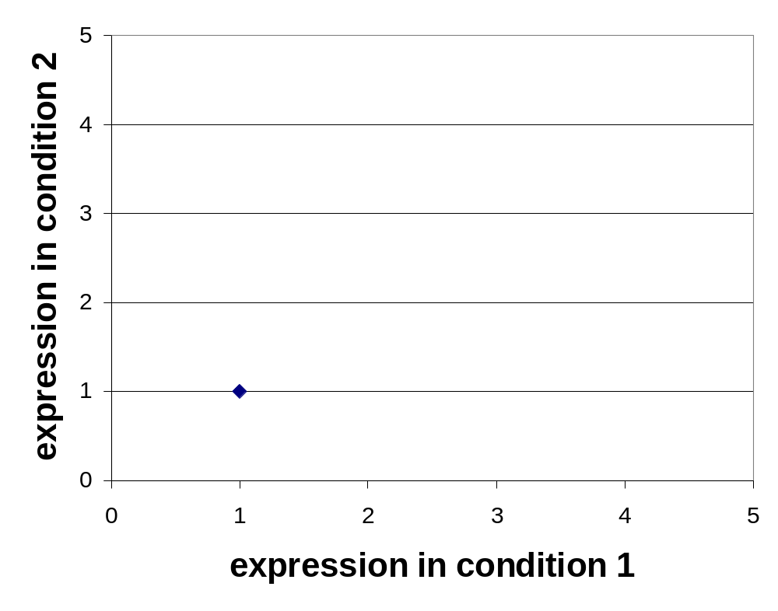
K-means Clustering: Step 5
Algorithm: k-means, Distance Metric: Euclidean Distance
k₁
k₂
k₃

Slide 17
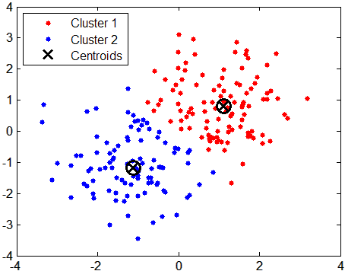
Data Clustering via Kmeans
Instead of 2D, kmeans can be applied to 3D color space RGB or L*a*b*
EE465: Introduction to Digital Image Processing Copyright Xin Li

Slide 18
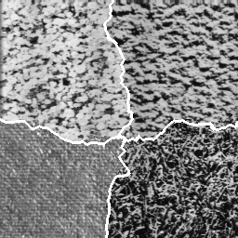
Texture-based Techniques
What is Texture?
No one exactly knows.
In the visual arts, texture
is the perceived surface quality
of an artwork.
EE465: Introduction to Digital Image Processing Copyright Xin Li

Slide 19
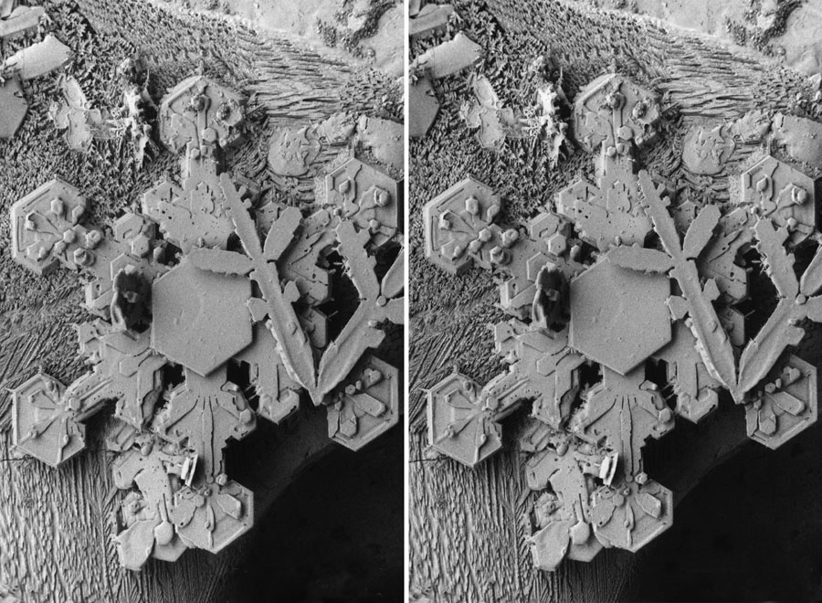
Disparity-based Techniques
EE465: Introduction to Digital Image Processing Copyright Xin Li

Slide 20

Motion Segmentation
EE465: Introduction to Digital Image Processing Copyright Xin Li

Slide 21
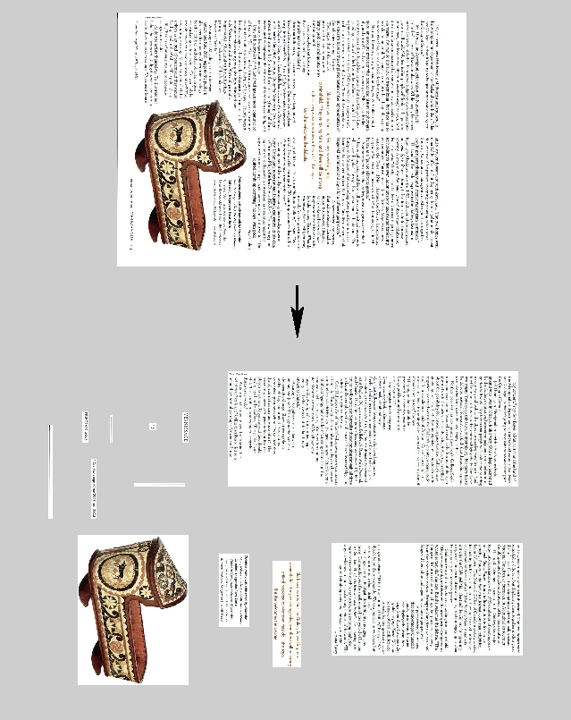
Document Segmentation
Document images consist of texts, graphics, photos and so on
Document segmentation is useful for compression, text recognition
Adobe and Xerox are the major players
EE465: Introduction to Digital Image Processing Copyright Xin Li

Slide 22
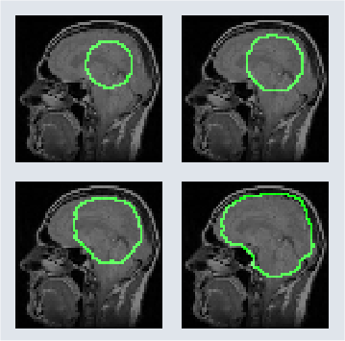
Medical Image Segmentation
Medical image analysis can be used as preliminary screening techniques to help doctors
Partial Differential Equation (PDE) has been used for segmenting medical images
active contour model (snake)
EE465: Introduction to Digital Image Processing Copyright Xin Li

Slide 23
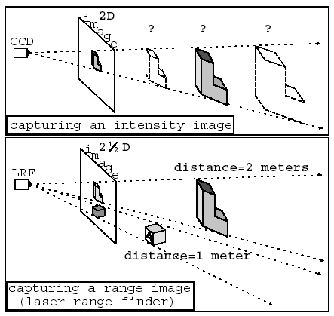
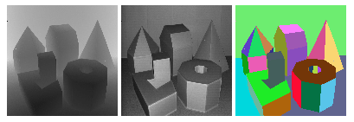
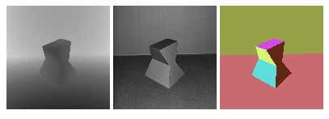
Range Image Segmentation
range
intensity
ground
truth
EE465: Introduction to Digital Image Processing Copyright Xin Li

Slide 24
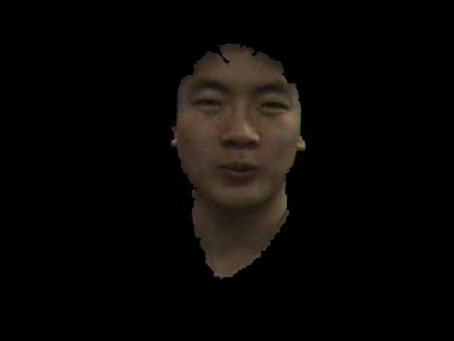
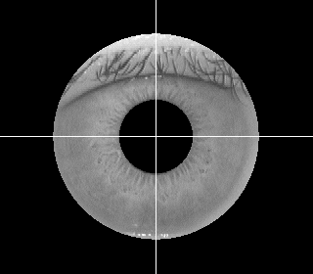
Biometric Image Segmentation
For fingerprint, face and iris images, we also need to segment out the region of interest
Various cues can be used such as ridge pattern, skin color and pupil shape
Robust segmentation could be difficult for poor-quality images
EE465: Introduction to Digital Image Processing Copyright Xin Li

